Slide 1
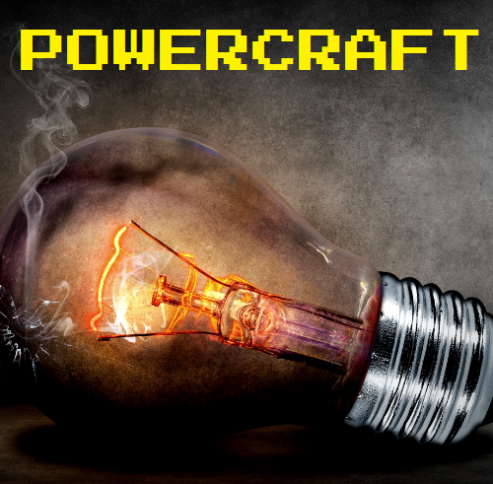
An educational tool that simulates power transmission
Sponsor: Daniel Conte de Leon
Team: Yamini & Chiranjeevi
Notes:
“Failure is the opportunity to begin again more intelligently.” – Henry Ford

Slide 2

Research & Exploration
Minecraft
Develop using existing mods (electrical age)
Terasology
Minetest
Mesecons mod
Develop a mod from scratch
Review electrical concepts
Notes:
Learning about AC - triple phase and single phase generators

Slide 3
Tasks
Create a mod
Register a node for the generator (Single-phase generator, we are implementing AC)
Implement variables and data structures to store and display electrical power system values (voltage, current, etc.)
Register a node for the light
Implement GUIs for user input (used with generator block and light block)
Create a cable used to transfer the electrical current to the connected device

Slide 4
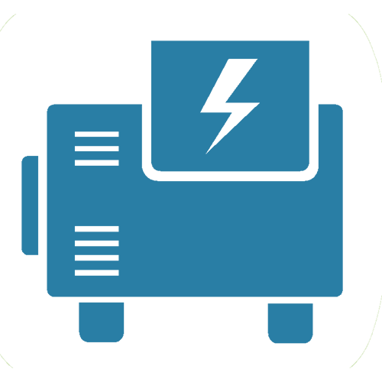
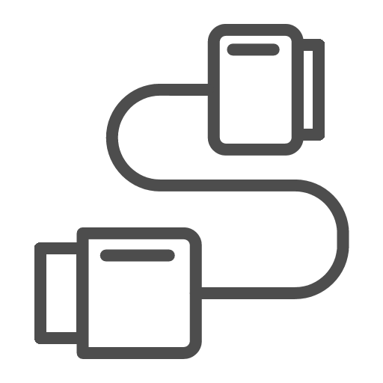

How it works
Step 1
Step 2
Step 3
Add a generator block
Attach cable block to generator
Attach light block to cable

Slide 5
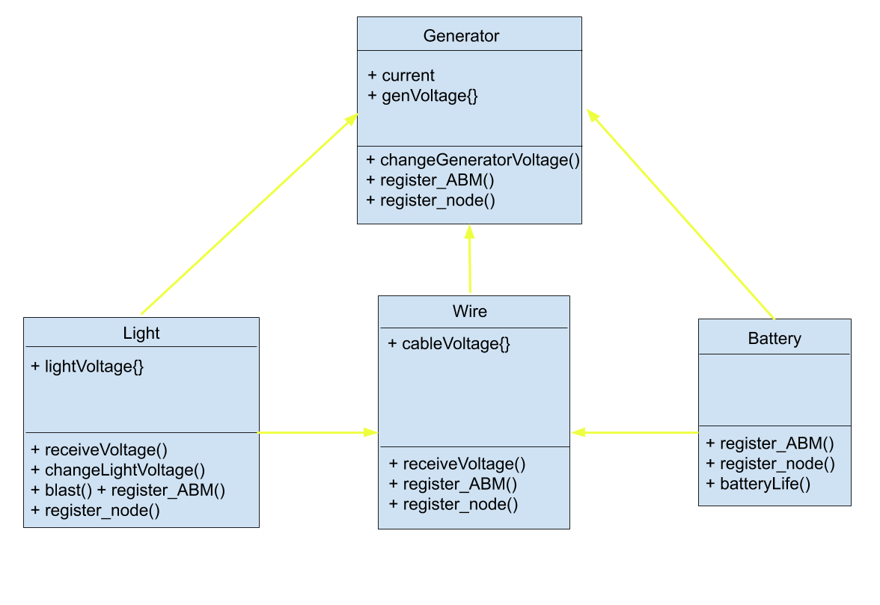
Class Diagram

Slide 6
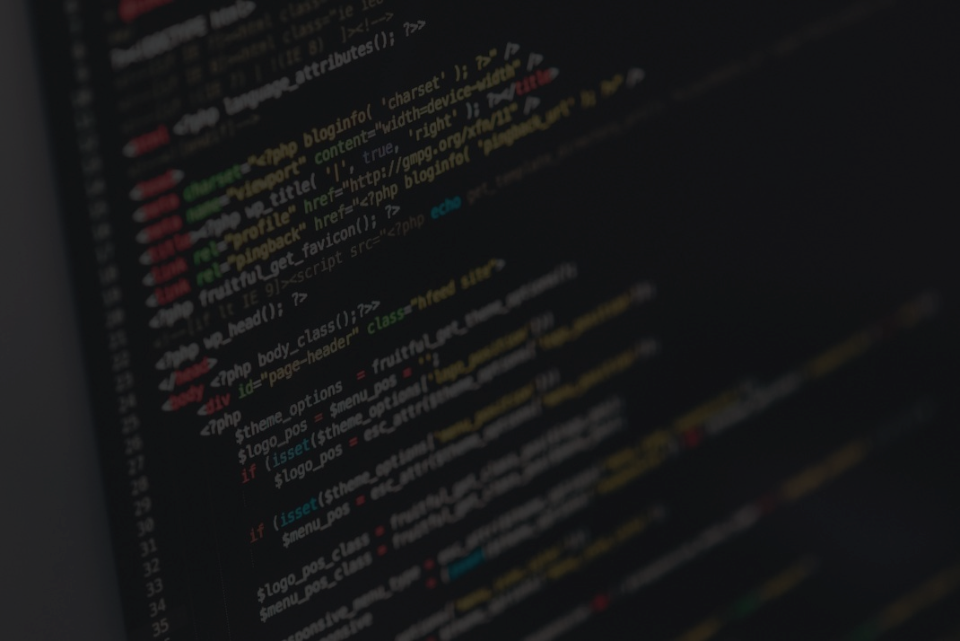


Development
Minetest Modding Book
Programming in Lua
Active Block Modifiers
Hash tables

Slide 7
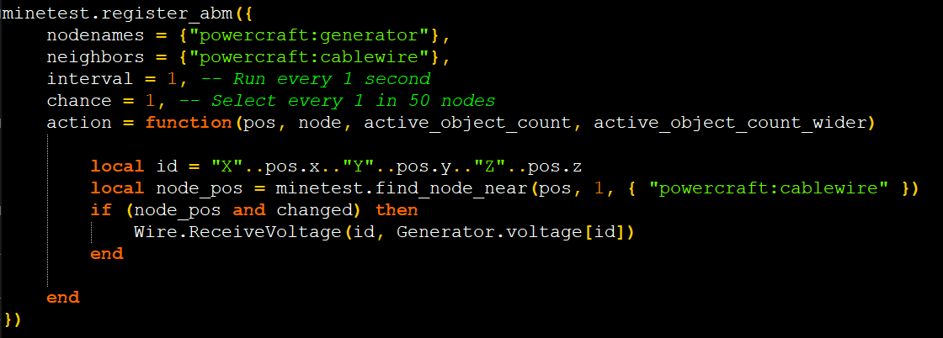
Code

Slide 8
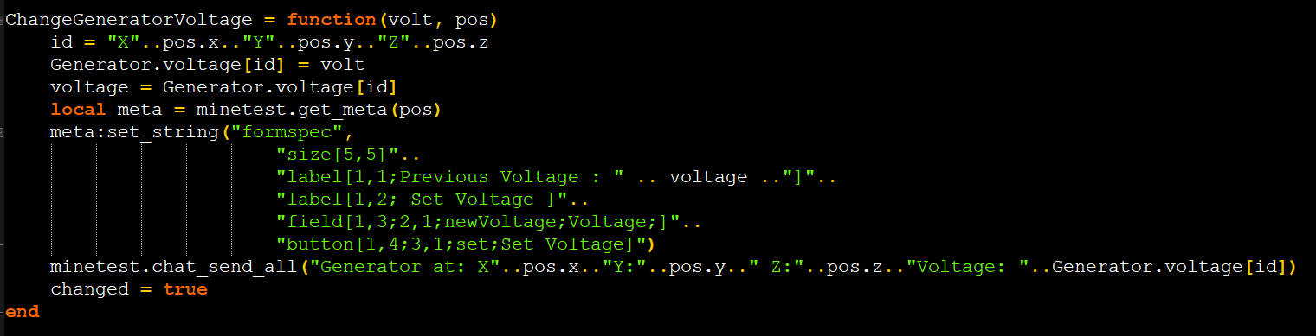
Code

Slide 9


Slide 10
Management
Weekly Team Meetings
Weekly Sponsor Meetings
Google Drive
Documentation

Slide 11

Future Work
Distributing current
Adding 2 or more generators
Adding 2 or more lights
Implement a battery to keep track of the current per second
Implement new nodes as power consuming devices (i.e. light, toaster, fan, etc)

Slide 12
Challenges & Lessons Learned
Starting from scratch
Learning a new programming language
Determine meeting schedule in the first two weeks of the semester
Communicate and meet regularly with all team members
Learn from similar projects that were previously implemented
Ask your sponsor questions
Document any and all discoveries

Slide 13

“At its heart engineering is about using science to find creative practical solutions. It’s a noble profession.” – Queen Elizabeth II

